Slide 1
Types of Sentences I
Week 6
By Mao Chengting

Slide 2
Goals
Types of sentences
Parallel structures & Sentence problems
Noun clauses
Common English mistakes by Chinese native speakers

Slide 3
1. Types of sentences

Slide 4
Types of sentences-Clauses
Independent clause (sentence)
Dependent clause
Academic integrity is important.
The sun rose.
Stanley broke the university rule.
Because academic integrity is important, …
When the sun rose, …
Since Stanley broke the university rule, …
Subordinators: 主从连词

Slide 5
4 Kinds of Sentences
Simple sentence
Compound sentence
Complex sentence
A compound-complex sentence

Slide 6
Simple & Compound Sentences
Simple sentence
Compound sentence
并列句
One independent clause
e.g.: She is good at math.
Two or more independent clauses joined together.
e.g.:
She is good at math, so she figured it out quickly.
She is good at math; (therefore,) she figured it out quickly.
(FAN BOYS: for, and, nor, but, or, yet, so)
Coordinators: 并列连词

Slide 7
Complex sentences (复合句)
One independent clause + one or more dependent clauses
Noun clause: e.g.: She does not agree that math is easy.
Adverb clause: e.g.: Because math is easy, I learned it quickly.
Adjective clause: e.g.: The lady I met in the canteen the other day was our dean.
主句
从句

Slide 8
Compound-complex sentences
A compound-complex sentence has two independent clauses, and one or more dependent clauses.
e.g.:
Because English grammar is easy, I learned it quickly, but it took me several years to master writing.
complex
compound

Slide 9
Practice 1
My father never attended the military parades in the city. He hated war.
All the candidate claim to understand Europeans. None has ever lived in Europe.
Many of the settlers had never farmed before. They were not ready for the brutal winters.
Burning fossil fuels causes holes in the ozone layer. We need to develop other sources of energy.
Every country should take action to use alternative energy. The future generations will suffer the consequences.

Slide 10
Keys
My father never attended the military parades in the city, for he hated war.
All the candidate claim to understand Europeans, but/yet none has ever lived in Europe.
Many of the settlers had never farmed before, nor were they ready for the brutal winters.
Burning fossil fuels causes holes in the ozone layer, so we need to develop other sources of energy.
Every country should take action to use alternative energy, or the future generations will suffer the consequences.

Slide 11
Practice 2
The planned negotiations will mainly cover issues that have not been resolved for example whether the US will lift tariff on Chinese products.
ICT is reaching out to help people in the poorest for example fruit farmers in the remote countryside can receive weather reports that tell them whether to make precautions.
In addition, when the farmers have the ripe fruit ready for sale they can find out the current market prices for that particular kind so that they can set an advantageous price.
The worldwide reach of the Internet is also providing employment opportunities in developing countries and as greater numbers of people learn the technology these opportunities will expand.

Slide 12
Keys
The planned negotiations will mainly cover issues that have not been resolved, for example, whether the US will lift tariff on Chinese products.
ICT is reaching out to help people in the poorest; for example, fruit farmers in the remote countryside can receive weather reports that tell them whether to make precautions.
In addition, when the farmers have the ripe fruit ready for sale, they can find out the current market prices for that particular kind so as to make better decisions.
The worldwide Internet connectivity is also providing employment opportunities in developing countries, and as greater numbers of people learn the technology, these opportunities will expand.

Slide 13
parallel structures & sentence problems

Slide 14
Parallelism
Taking courses for one’s major is as important as to take general courses.
Einstein is not only a genius in physics but also he is a musician.
Taking courses for one’s major is as important as taking general courses.
Einstein is not only a genius in physics but also a musician.

Slide 15
Parallelism with correlative (paired) conjunctions:
and, or, but
both…and…
either… or…
neither…nor…
not only…but also…

Slide 16

P1: Fragments
X: The teacher whom I respected the most in high school.
V: The teacher I respected the most in high school was Mr. Smith.
Hint: Always check subject-verb-(object).

Slide 17
Exercise
The common goal for mankind to live in peace and harmony.
Second, the fact that summer in this area is much hotter than other places.
For example, many students join interest clubs to spend their spare time.
Although people do believe that all men are created equal.

Slide 18

P2: Run-ons
X Getting married is easy staying married is another matter.
Getting married is easy, staying married is another matter.
Getting married is easy, but staying married is another matter.
Getting married is easy; (however,) staying married is another matter.
X
V
V

Slide 19

P3: Choppy sentences
X: Oliver left his homeland. Then he lived in a foster family. Then he got his documents. Then he traveled to Australia. And he lives there now.
V: After Oliver left his homeland, he lived in a foster family for several months. As soon as he got his documents, he traveled to Australia, where he lives now.

Slide 20
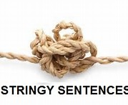
P4: Stringy sentences
X: Oliver left his homeland, and he lived in a foster family for several months, but finally he got his documents, so he traveled to Australia, and he lives there now.
V: After Oliver left his homeland, he lived in a foster family for several months. As soon as he got his documents, he traveled to Australia, and lives there now.

Slide 21
Noun clauses

Slide 22
Noun Clauses
Types:
That clauses
Subjunctive noun clauses
Question clauses
If/whether clauses
What’s the function of noun/noun clause in a sentence?
To be the subject or the object

Slide 23
1. That clauses
Formed from statements
Introduced by subordinator that
That can be omitted if the noun clause serves as the object
e.g.: The prize-winning writer and his wife told the press (that) they were enjoying their visit.
e.g.: That his book is a critical success is beyond doubt.
宾语

Slide 24
2. Subjunctive noun clauses
Verb in base form
Occur after verbs and adjectives of urgency, advisability, necessity, and desirability
e.g.: The president of the University demanded that whoever fails more than 3 courses be expelled.

Slide 25
3. Question clauses
Formed with wh- question;
Use subject-verb statement word order
“Do”, “does”, “did” disappear
e.g.: The police do not know who committed the robbery.
V The police do not know when the robbery happened.
X: The police do not know when did the robbery happen.
e.g.: What is your name? → He asks what your name is.

Slide 26
4. If/whether clauses
Formed from yes/no questions
Introduces by subordinator if or whether; whether is more formal than if;
Use subject-verb statement word order
“Do, does, did” disappear
e.g.: The question is whether foreign companies understand the local business environment (or not) .
e.g.: No one knows if the experiment will succeed (or not) .

Slide 27
Common English Mistakes Made by Native Chinese Speakers

Slide 28
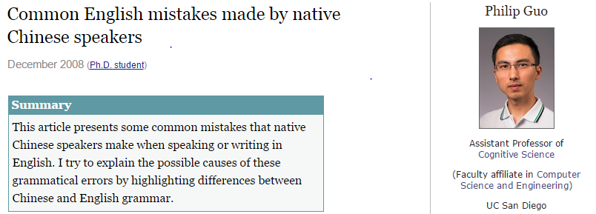
According to research…
http://www.pgbovine.net/chinese-english-mistakes.htm

Slide 29
Common mistakes
GENDER CONFUSION
SINGULAR/PLURAL NOUN CONFUSION
SUBJECT-VERB AGREEMENT CONFUSION
VERB TENSE CONFUSION
OMITTING OR INSERTING ARTICLES
CONFUSING PREPOSITIONS
MIXING UP FIRST AND LAST NAMES

Slide 30
Examples of multiple mistakes
"Yesterday I go to market to buy three duck."
"Mary like to eat meat; he definitely not vegetarian."
"He like to go to mall to shop for the clothing."
"Last week he get good job at big city."
Yesterday I went to a market to buy three ducks
Mary likes to eat meat, so she definitely is not a vegetarian.
He likes to go to a mall to shop for (无the)clothing.
Last week he got a good job in a big city

Slide 31
Review
Types of sentences: Balance!
Using parallel structures and fixing sentence problems: Parallelism!
Noun clauses: Editing!
Common English mistakes made by native Chinese speakers: Keep editing!

